Slide 1
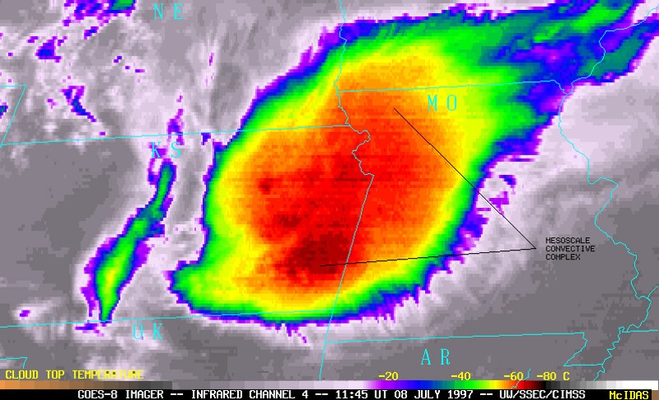



Changes in mesoscale convective system structure with ENSO phase
Sylvia Sullivan and Pierre Gentine
Department of Earth and Environmental Engineering, Columbia University
scs2229@columbia.edu, pg2328@columbia.edu
EGU 2018-1273: NP2.1/AS1.25/CL2.10/OS1.13
Background image from NASA/NOAA/UWM-CIMSS (1997)

Slide 2
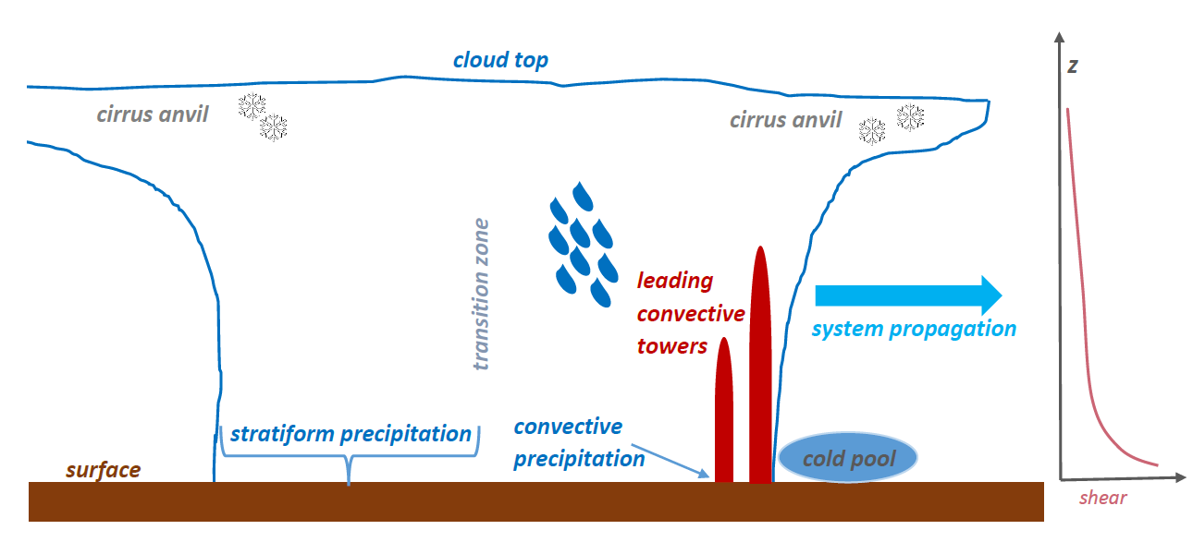
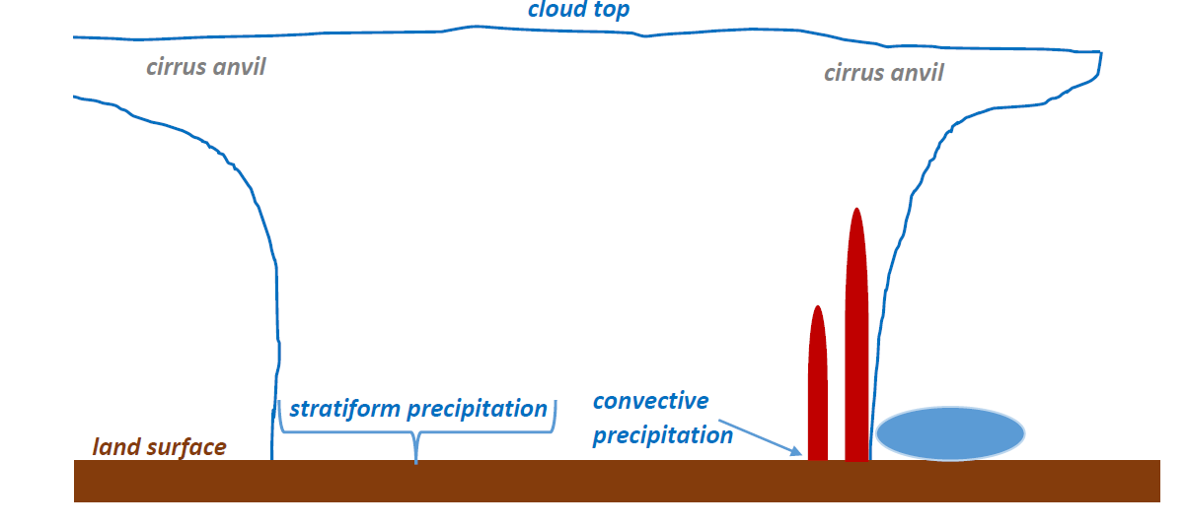
A mesoscale convective system is an agglomeration of thunderstorms with convective and stratiform regions.
Extensive cirrus anvils warm radiatively.
Large rainfall volume or intensity can result.
Notes:
We care about MCS because (1) their extensive cirrus anvils can cause surface radiative warming (2) their convective cores cause heavy, localized rainfall. We would like to know how these systems change with warming. This has been done by several studies in the past, but primarily with idealized modeling and there are limitations (boundary conditions, turbulence + microphysics parameterizations, etc.) to these.

Slide 3


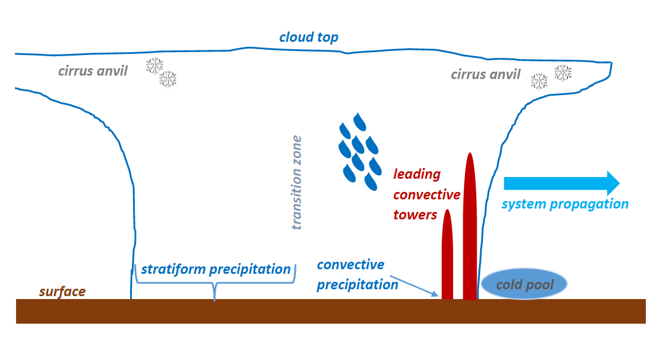

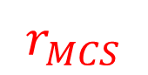

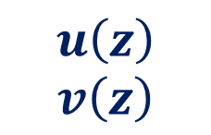


We use various datasets to understand the structure and impact of the systems.
ERA-Interim
Convective tracking
$$T_{top, MCS}$$
$$u\left(z\right)$$
$$v\left(z\right)$$
$$r_{MCS}$$
$$n_{comp, MCS}$$
Radiation
$$MSE(z)$$
Notes:
-- Because these systems – their frequency and properties – are highly variable, we will need data with long temporal range and complete spatial coverage. This allows us to construct climatologies and generalize.
-- This leads to a scale issue. MCS are mesoscale phenomena, whose structure and propagation should be determined by mesoscale meteorological conditions. But we would also like to understand their interactions / feedbacks with large-scale energy balances, precipitation budgets, and circulation. With climatologies, we can begin to bridge this scale gap.
-- El Nino provides a proxy for large-scale surface warming, although there are caveats to the proxy and simple understanding of system changes with ENSO phase is interesting unto itself.
some nice analogy or conceptual framework – heat engine thing …?

Slide 4
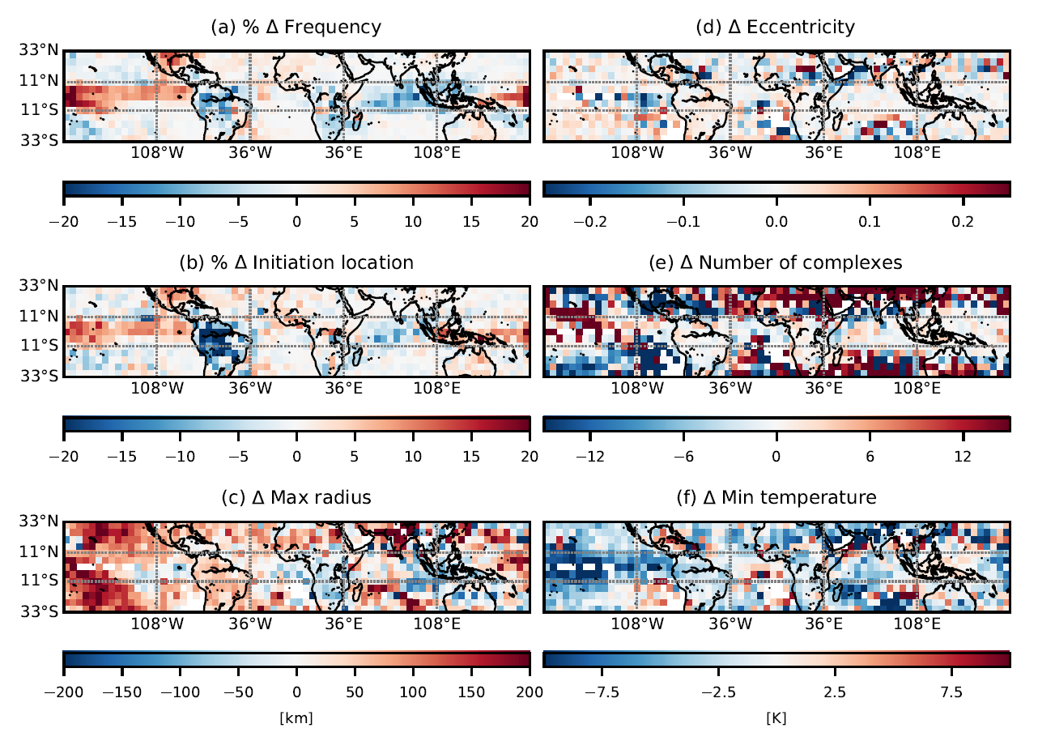
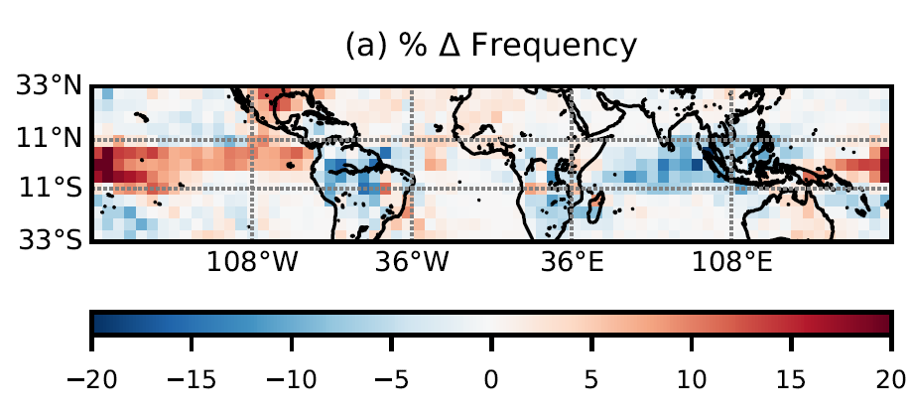
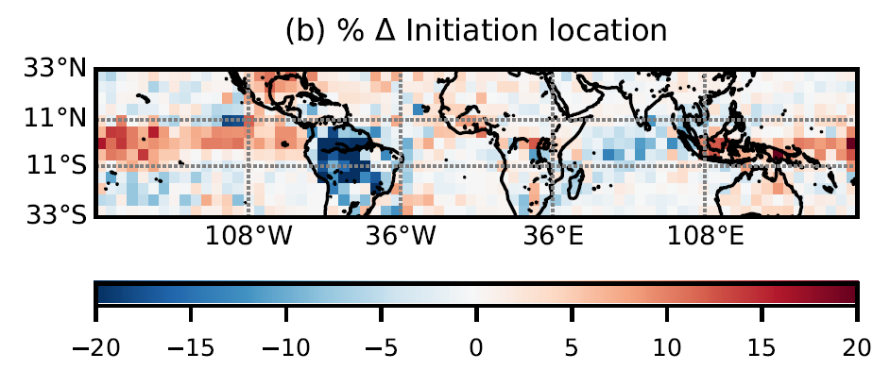
DJF climatology
Notes:
Blue means the value is larger in a La Nina year; red in an El Nino year.
FREQUENCY:
The simplest question we can ask is if these systems are more frequent when the surface is warmer. The answer is no when we look at the tropics in their entirety; there is large variability in system occurrence. But for smaller subdomains, particularly oceanic ones and the Amazon ones (which are interestingly similar), there are statistically significant shifts.
Very expected Pacific “dipole” behavior:
Increase in the MCS frequency over the central Pacific where the SST increase is greatest.
But the region of increased frequency also extends all the way eastward to the South American coast.
When the ocean surface near the Amazon cools (La Nina), the warmer forest surface becomes favorable for system development. (This is less true over the Maritime continent because the SST changes west of the International Date Line are smaller than those east of the Date Line.
(2) Decrease in the MCS frequency over the west Pacific (Maritime Continent) where the SST has dropped.
But there are also decreases in frequency of passage over the Amazon, Sahel, and Indian Ocean during the warm phase.
Frequency shifts and initiation shifts generally mirror one another, but the decrease over the Amazon is more intense and the increase over the central Pacific is less so for the initiation field.

Slide 5
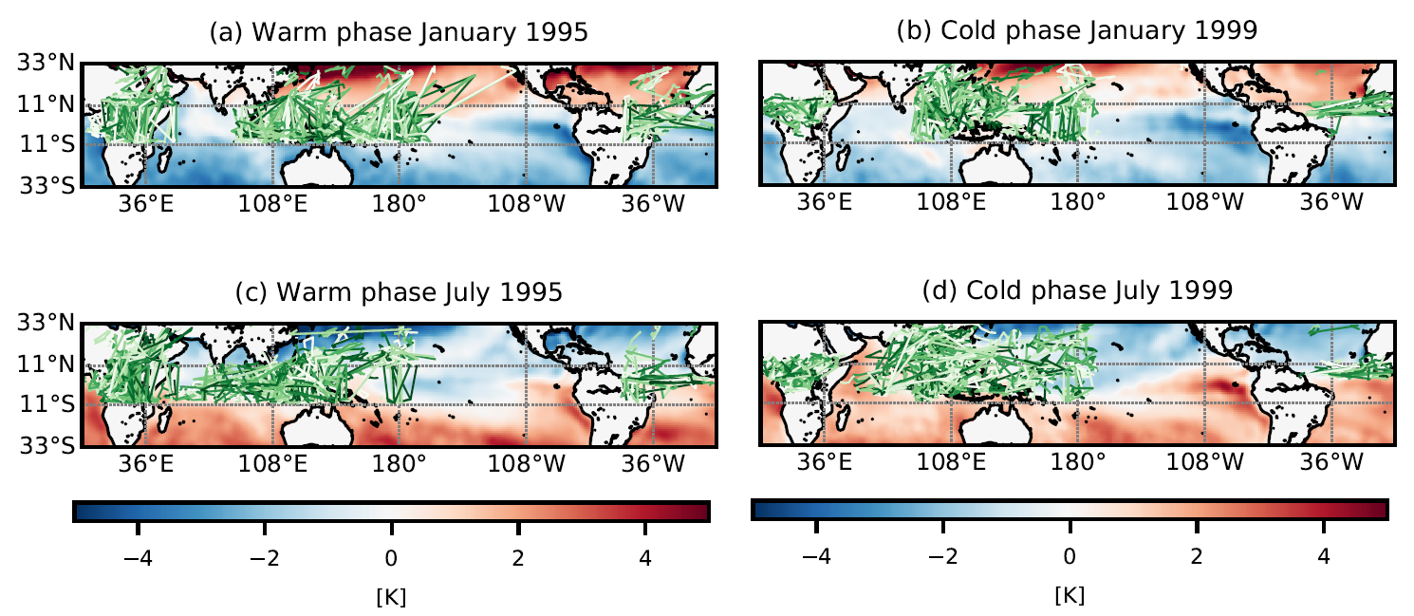
Shifts in MCS tracks mirror those in passage frequency and initiation.
intensification of tracks in the Central Pacific
intensification of trans-Atlantic tracks
less intense Indian monsoon

Slide 6
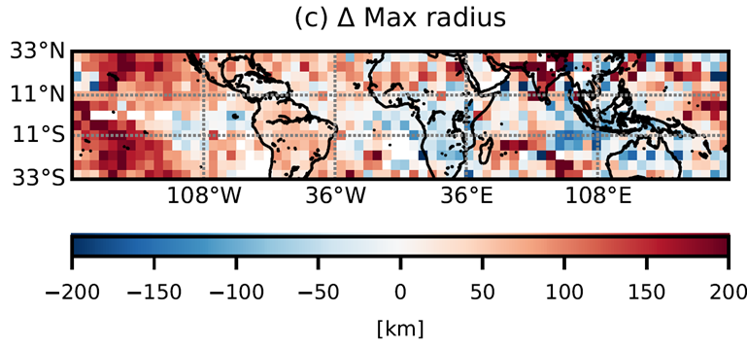
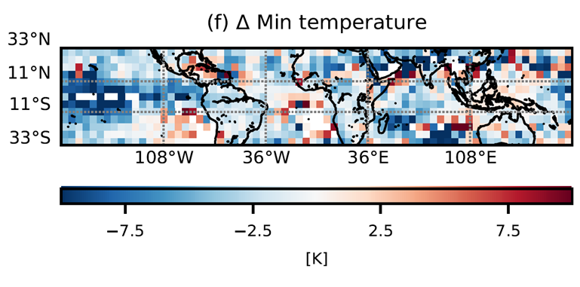
DJF climatology
Are the changes in MCS structure associated with changes in energetics?
Notes:
Discuss these fields in general first. Generally max radius is increasing in the warm phase, generally minimum temperature is decreasing in the warm phase. The storms are just BIGGER overall.
Another way to understand this question is, is the same quantity of moisture simply being concentrated in a narrow and elongated column? Or is there more moisture contained in the one structure versus the other?

Slide 7
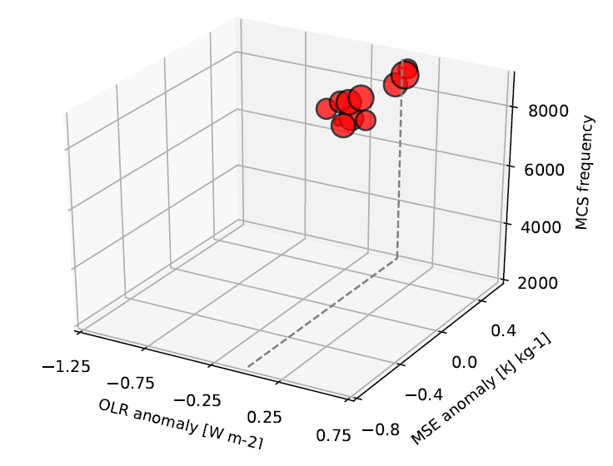
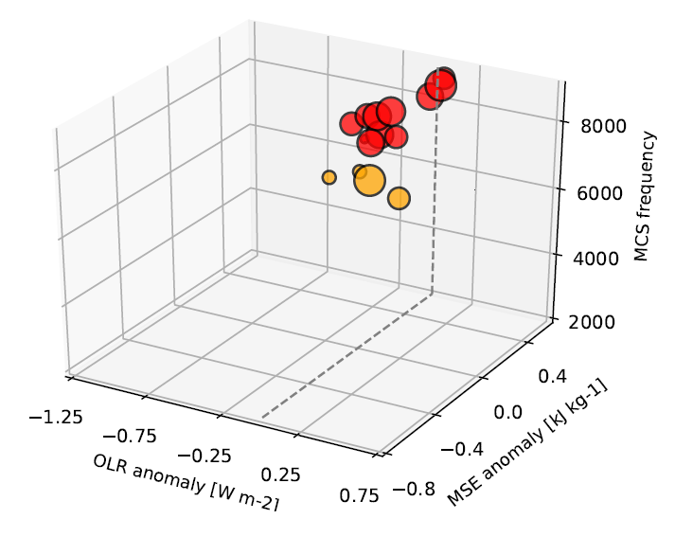
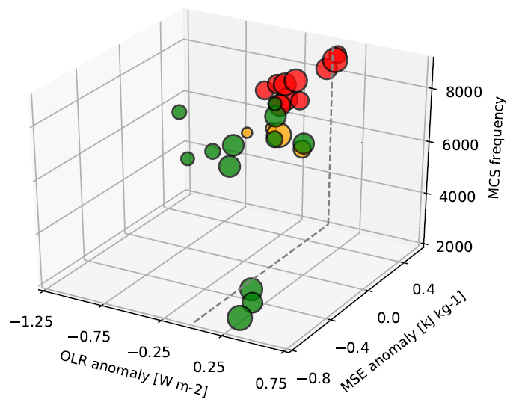
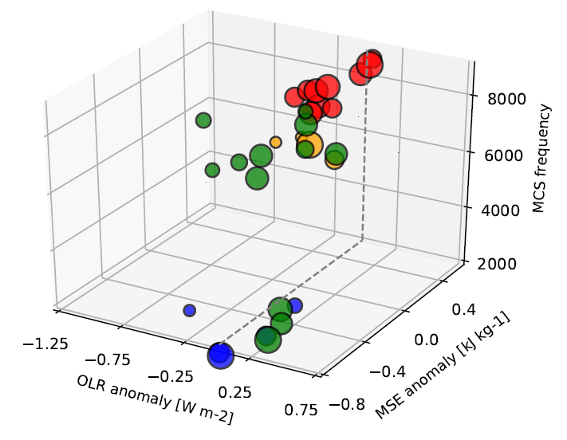
The different seasons and phases inhabit different parts of a frequency-MSEa-OLRa space.
Negative OLRa
Positive MSEa
High MCS frequency
Warm phase – DJF
Warm phase – JJA
Cold phase – DJF
Cold phase - JJA
Negligible OLRa
Negative MSEa
Low MCS frequency
Notes:
The size of the circles is the size of the storm.

Slide 8
DJF climatology
Can we understand the structural changes in a more dynamic way?

Slide 9
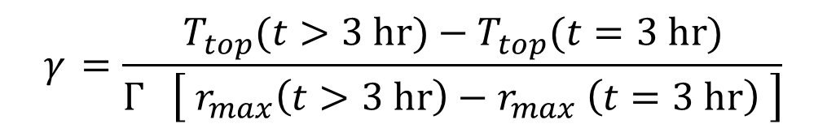
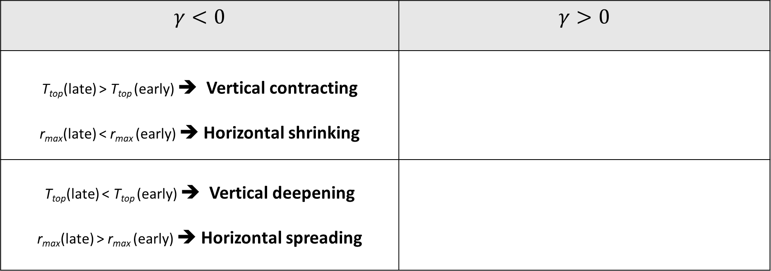
Can we understand the structural changes in a more dynamic way?
system growth metric
$$γ_{ }=\frac{T_{top}^{}(t>3 hr)−T_{top}^{}(t=3 hr)}{Γ \left[ r_{max}^{}\left(t>3 hr\right)−r_{max}^{} \left(t=3 hr\right) \right]}$$
$$γ<0$$ | $$γ>0$$
T_{top}(late) > T_{top} (early) ➔ Vertical contracting r_{max}(late) < r_{max} (early) ➔ Horizontal shrinking
T_{top}(late) < T_{top} (early) ➔ Vertical deepening r_{max}(late) > r_{max} (early) ➔ Horizontal spreading
Notes:
The ideas of upped-ante mechanism and the OLR signature (from moisture redistribution in the system) employ climatologies of properties and conditions over systems of all lifetimes. Can we also learn something about how systems tend to evolve in the warm versus cold phase? To do this, a growth metric is defined.
In the gamma difference fields we see negative values often. If gamma generally has a negative magnitude, as in the absolute field for the warm phase, then the growth metric is more negative in the cold phase. This means the systems are vertically contracting and horizontally shrinking more quickly during the cold phase. They are decaying more quickly in the cold phase.
In any regions where the gamma difference is positive, the opposite effect should be at play. The systems are decaying faster for the warm phase.
Generally the system growth metric is negative, meaning that generally the vertical deepening and horizontal spreading of the systems occurs rapidly after system initiation and then decays away. And generally it is more negative in the cold phase, so systems contract or shrink more dramatically

Slide 10
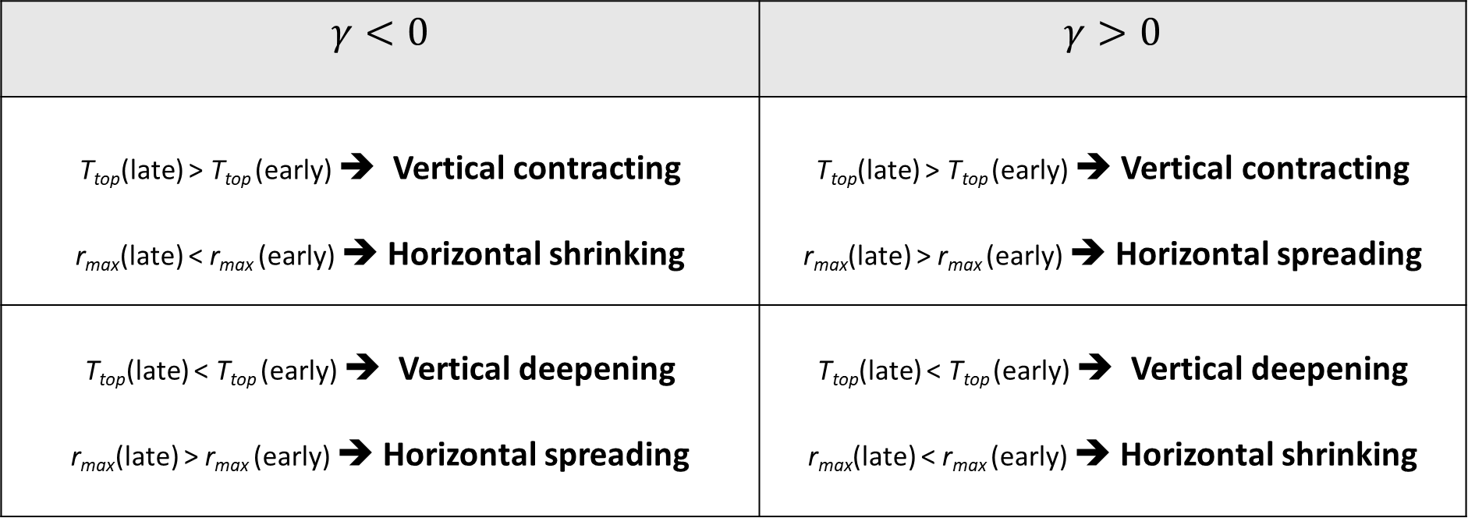
Can we understand the structural changes in a more dynamic way?
system growth metric
$$γ_{ }=\frac{T_{top}^{}(t>3 hr)−T_{top}^{}(t=3 hr)}{Γ \left[ r_{max}^{}\left(t>3 hr\right)−r_{max}^{} \left(t=3 hr\right) \right]}$$
$$γ<0$$ | $$γ>0$$
T_{top}(late) > T_{top} (early) ➔ Vertical contracting r_{max}(late) < r_{max} (early) ➔ Horizontal shrinking | T_{top}(late) > T_{top} (early) ➔ Vertical contracting r_{max}(late) > r_{max} (early) ➔ Horizontal spreading
T_{top}(late) < T_{top} (early) ➔ Vertical deepening r_{max}(late) > r_{max} (early) ➔ Horizontal spreading | T_{top}(late) < T_{top} (early) ➔ Vertical deepening r_{max}(late) < r_{max} (early) ➔ Horizontal shrinking
Notes:
The ideas of upped-ante mechanism and the OLR signature (from moisture redistribution in the system) employ climatologies of properties and conditions over systems of all lifetimes. Can we also learn something about how systems tend to evolve in the warm versus cold phase? To do this, a growth metric is defined.
In the gamma difference fields we see negative values often. If gamma generally has a negative magnitude, as in the absolute field for the warm phase, then the growth metric is more negative in the cold phase. This means the systems are vertically contracting and horizontally shrinking more quickly during the cold phase. They are decaying more quickly in the cold phase.
In any regions where the gamma difference is positive, the opposite effect should be at play. The systems are decaying faster for the warm phase.
Generally the system growth metric is negative, meaning that generally the vertical deepening and horizontal spreading of the systems occurs rapidly after system initiation and then decays away. And generally it is more negative in the cold phase, so systems contract or shrink more dramatically

Slide 11
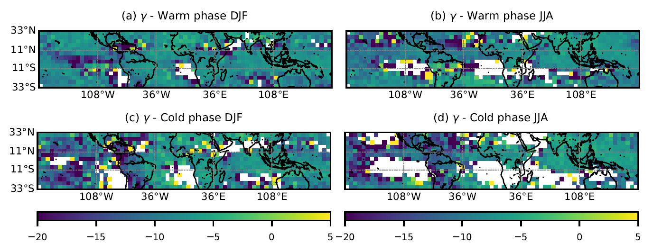
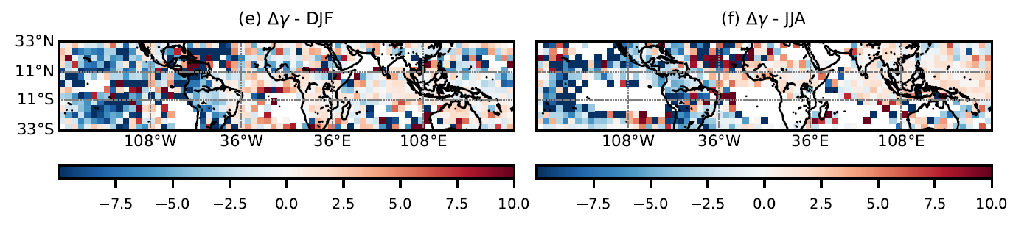
The system growth metric is generally negative…
…with larger warm-phase magnitude in some regions…
…and larger cold-phase magnitude in others.

Slide 12
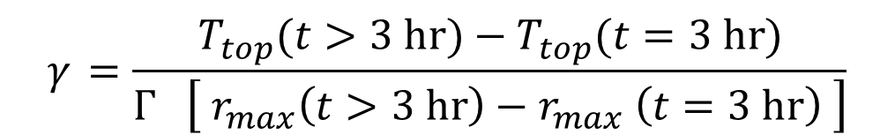
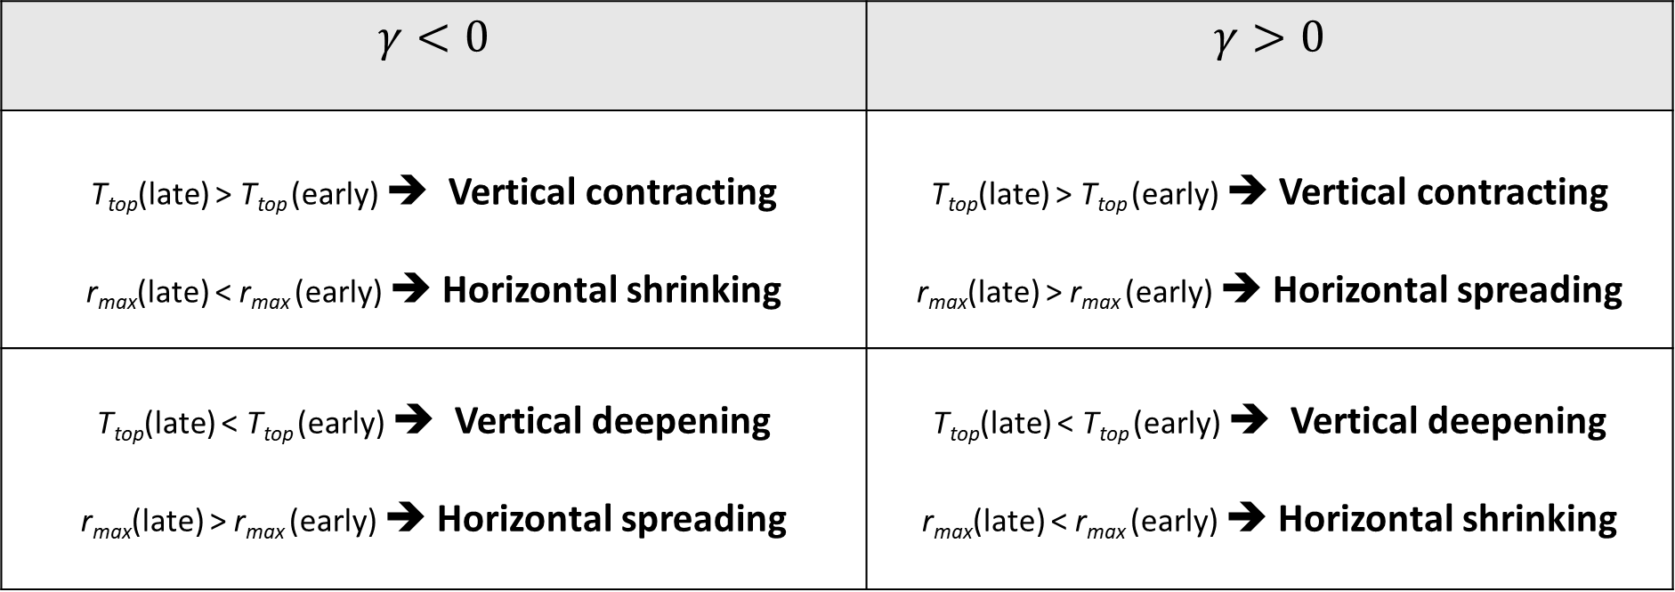
system growth metric
$$γ_{ }=\frac{T_{top}^{}(t>3 hr)−T_{top}^{}(t=3 hr)}{Γ \left[ r_{max}^{}\left(t>3 hr\right)−r_{max}^{} \left(t=3 hr\right) \right]}$$
$$γ<0$$ | $$γ>0$$
T_{top}(late) > T_{top} (early) ➔ Vertical contracting r_{max}(late) < r_{max} (early) ➔ Horizontal shrinking | T_{top}(late) > T_{top} (early) ➔ Vertical contracting r_{max}(late) > r_{max} (early) ➔ Horizontal spreading
T_{top}(late) < T_{top} (early) ➔ Vertical deepening r_{max}(late) > r_{max} (early) ➔ Horizontal spreading | T_{top}(late) < T_{top} (early) ➔ Vertical deepening r_{max}(late) < r_{max} (early) ➔ Horizontal shrinking
Notes:
The ideas of upped-ante mechanism and the OLR signature (from moisture redistribution in the system) employ climatologies of properties and conditions over systems of all lifetimes. Can we also learn something about how systems tend to evolve in the warm versus cold phase? To do this, a growth metric is defined.
In the gamma difference fields we see negative values often. If gamma generally has a negative magnitude, as in the absolute field for the warm phase, then the growth metric is more negative in the cold phase. This means the systems are vertically contracting and horizontally shrinking more quickly during the cold phase. They are decaying more quickly in the cold phase.
In any regions where the gamma difference is positive, the opposite effect should be at play. The systems are decaying faster for the warm phase.
Generally the system growth metric is negative, meaning that generally the vertical deepening and horizontal spreading of the systems occurs rapidly after system initiation and then decays away. And generally it is more negative in the cold phase, so systems contract or shrink more dramatically

Slide 13
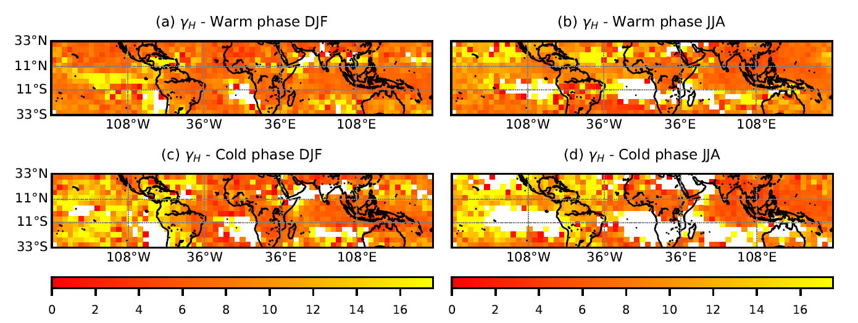
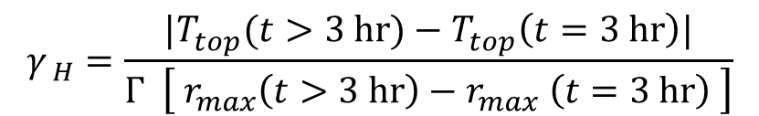
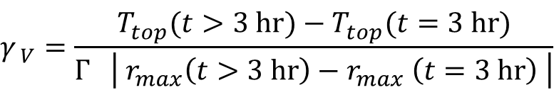
We can decompose the metric further to distinguish “growth quadrants”.
system horizontal growth metric
system vertical growth metric
$$γ_{ H}=\frac{|T_{top}^{}(t>3 hr)−T_{top}^{}\left(t=3 hr\right)|}{Γ \left[ r_{max}^{}\left(t>3 hr\right)−r_{max}^{} \left(t=3 hr\right) \right]}$$
$$γ_{ V}=\frac{T_{top}^{}(t>3 hr)−T_{top}^{}(t=3 hr)}{Γ \left| r_{max}^{}\left(t>3 hr\right)−r_{max}^{} \left(t=3 hr\right) \right|}$$

Slide 14
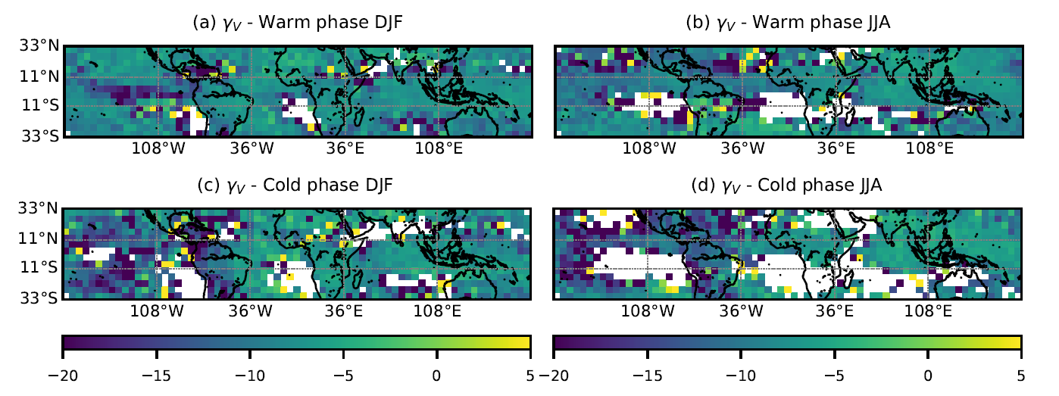
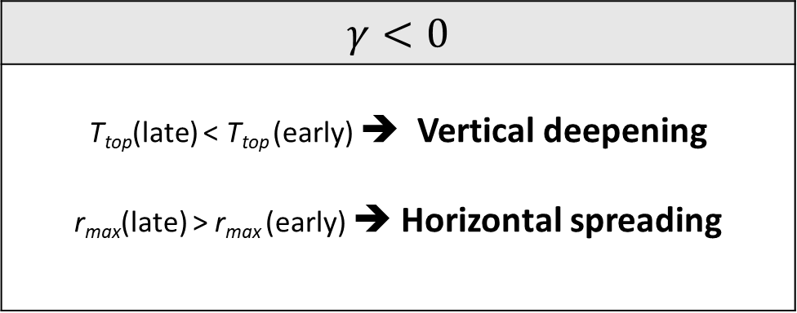
Systems are deepening and spreading over time.
system horizontal growth metric
system vertical growth metric
$$γ_{ H}=\frac{|T_{top}^{}(t>3 hr)−T_{top}^{}\left(t=3 hr\right)|}{Γ \left[ r_{max}^{}\left(t>3 hr\right)−r_{max}^{} \left(t=3 hr\right) \right]}$$
$$γ_{ V}=\frac{T_{top}^{}(t>3 hr)−T_{top}^{}(t=3 hr)}{Γ \left| r_{max}^{}\left(t>3 hr\right)−r_{max}^{} \left(t=3 hr\right) \right|}$$
$$γ<0$$
T_{top}(late) < T_{top} (early) ➔ Vertical deepening r_{max}(late) > r_{max} (early) ➔ Horizontal spreading

Slide 15
How does this system deepening and spreading change with ENSO phase?
dramatic increases in growth over the Pacific during the warm phase
lower-magnitude increases in growth over the Atlantic during the cold phase

Slide 16
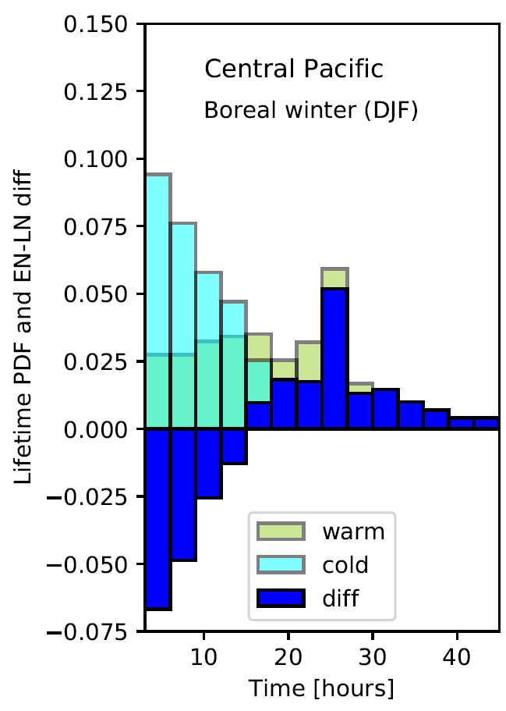
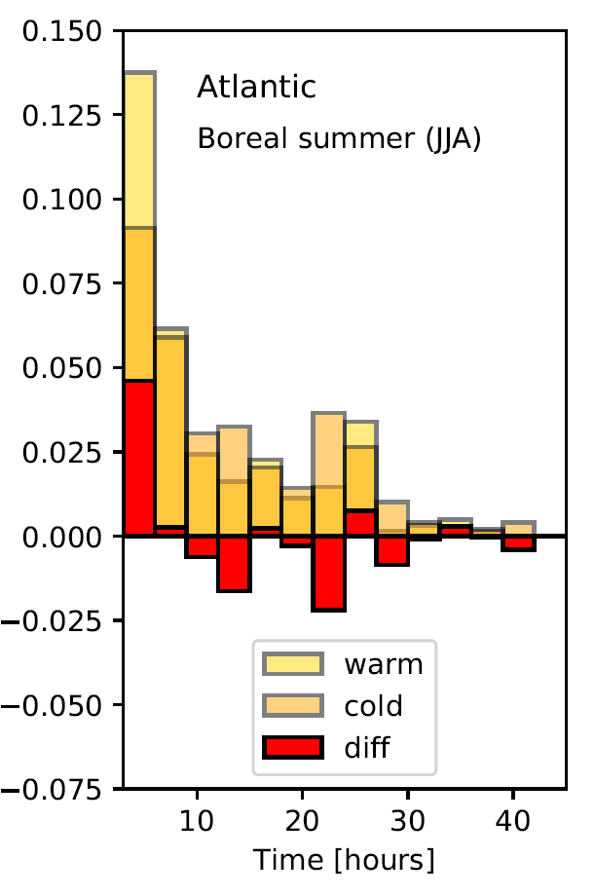
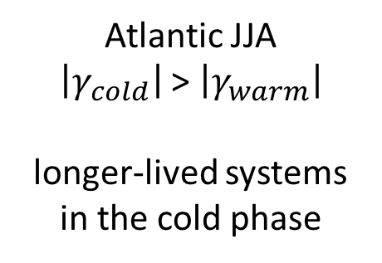
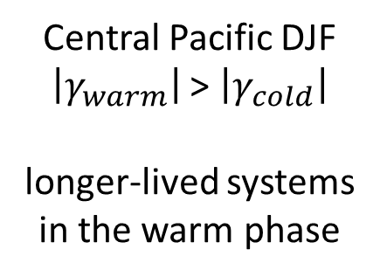
And this dipole behavior appears in MCS lifetime distributions also: the systems that grow larger live longer.
Central Pacific DJF
$\left|γ_{warm}\right|$ > $\left|γ_{cold}\right|$
longer-lived systems in the warm phase
Atlantic JJA
$\left|γ_{cold}\right|$ > $\left|γ_{warm}\right|$
longer-lived systems in the cold phase

Slide 17
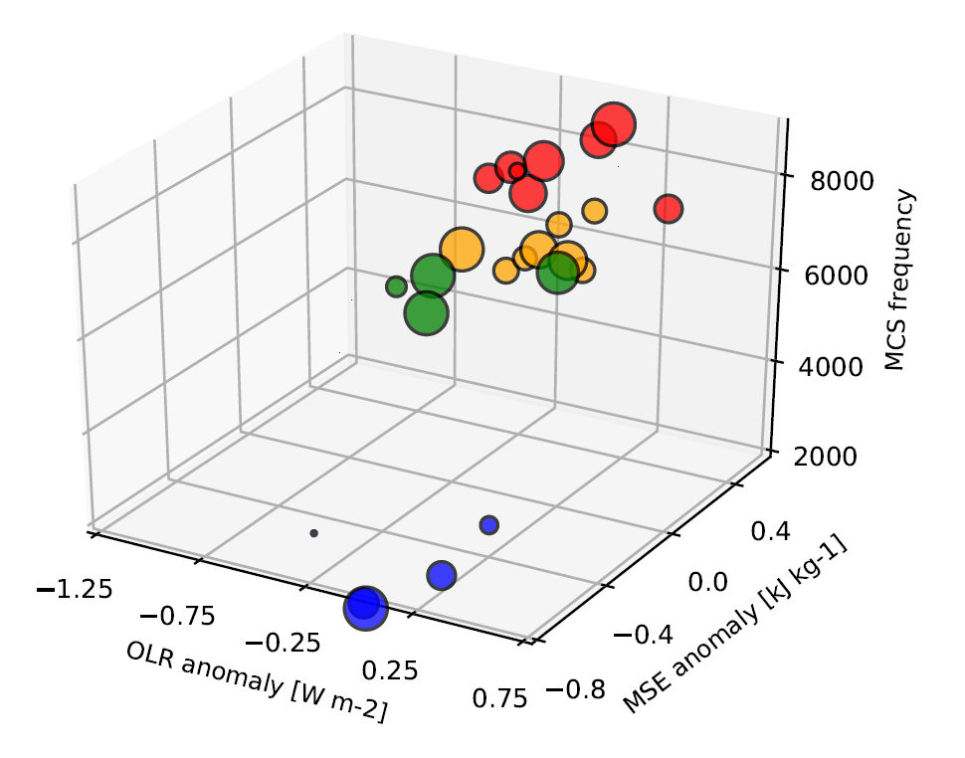
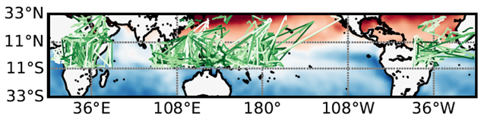
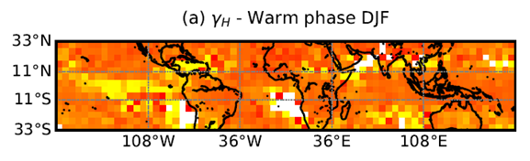
Summary
(2) MCS energetics also vary by season and ENSO phase, with greater OLRa in the warm phase.
(1) MCS frequency, initiation, and tracks shift with the El Niño surface warming anomalies.
(3) System growth metric analysis shows MCS horizontal and vertical spread over time, especially in the warm phase.
(4) Outlook: Do larger warm-phase MCS bring more precipitation…?
Notes:
For point 1
- monsoon intensification during La Niña
- eastward shift of the Pacific convective hotspot during El Niño
- trans-Atlantic intensification during El Niño
For point 2
large (at least for a value averaged over all of the tropics) negative OLR anomaly associated with MCS-collocated points during the warm season
large positive MSE anomaly during the warm phase
And high MCS frequency
Small or negligible OLRa, negative MSEa, and few systems for cold phase
For point 3

Slide 18
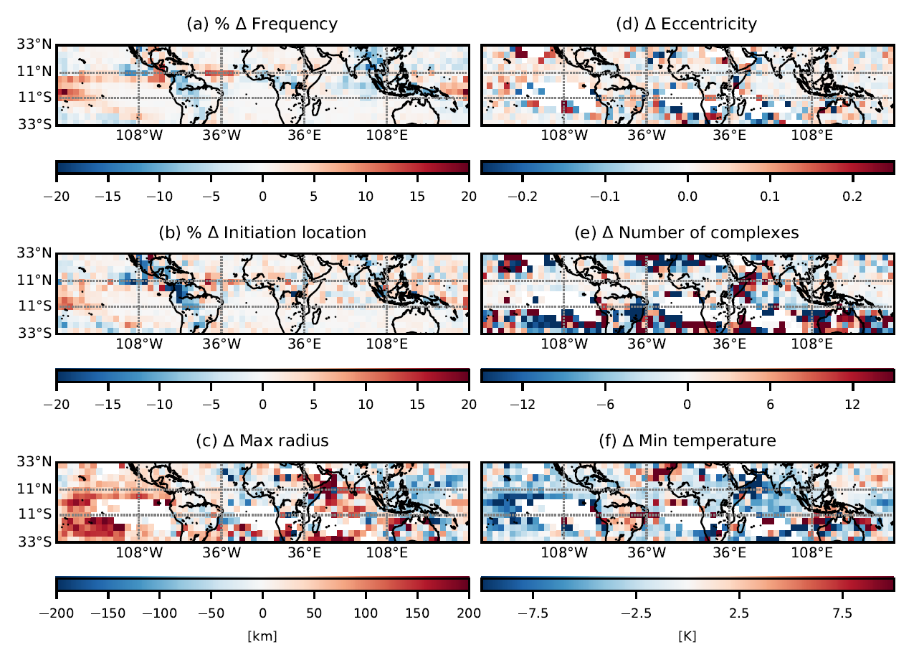
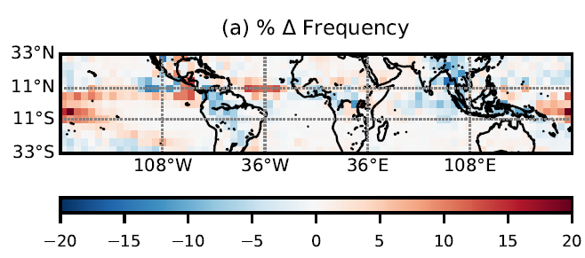
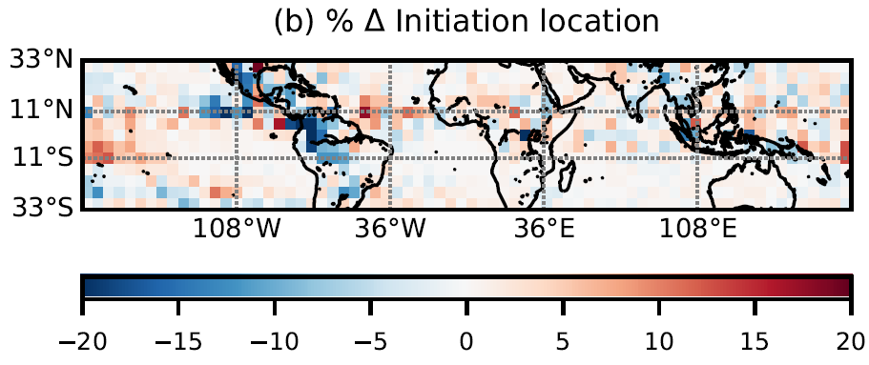
JJA climatology
Notes:
Convective zones shift northward with the ITCZ during boreal summer. The increase in system number is less dramatic than in DJF, but there is a greater increase in the Northern Atlantic.
As in DJF, frequency and initiation shifts generally mirror one another, but the decrease over the Amazon is more intense and the increase over the central Pacific is less so for the initiation field.

Slide 19
DJF climatology
In southern Africa, both system extent and depth decrease with warming. Is an “upped-ante mechanism” at play?
Notes:
Blue means the value is larger in a La Nina year; red in an El Nino year.
FREQUENCY:
Very expected Pacific “dipole” behavior:
Increase in the MCS frequency over the central Pacific where the SST increase is greatest.
But the region of increased frequency also extends all the way eastward to the South American coast.
(2) Decrease in the MCS frequency over the west Pacific (Maritime Continent) where the SST has dropped.
But there are also decreases in frequency of passage over the Amazon, Sahel, and Indian Ocean during the warm phase.

Slide 20
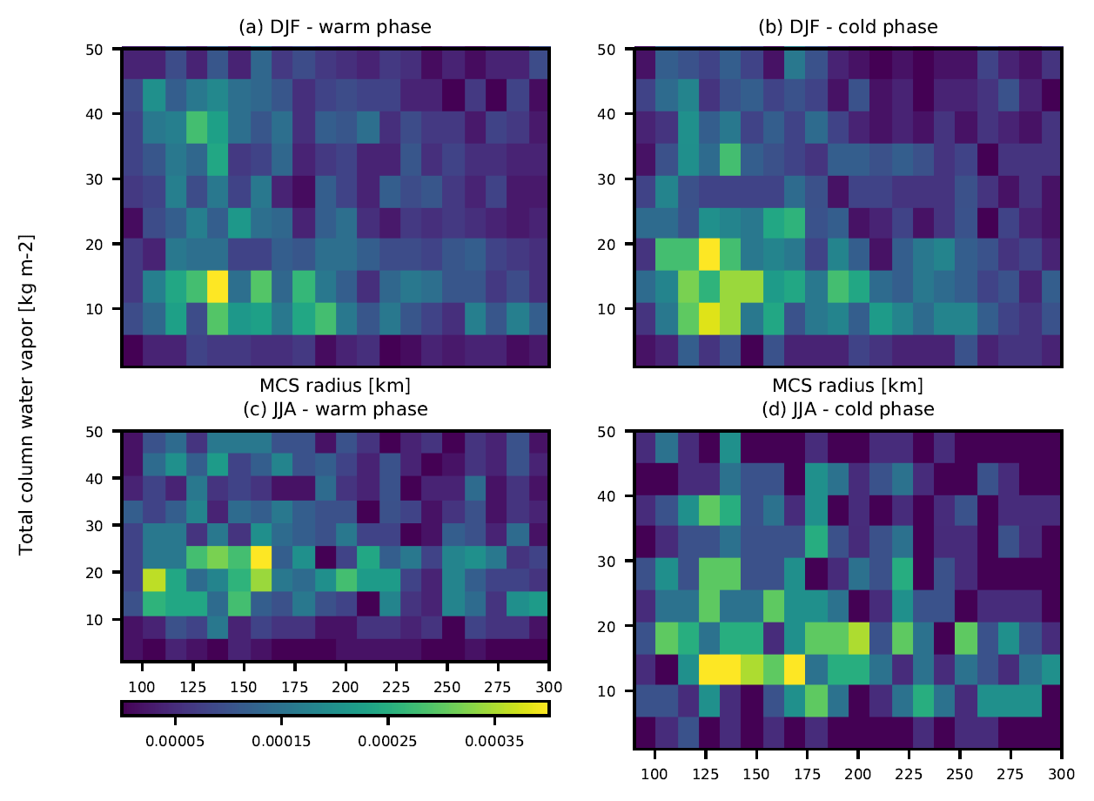
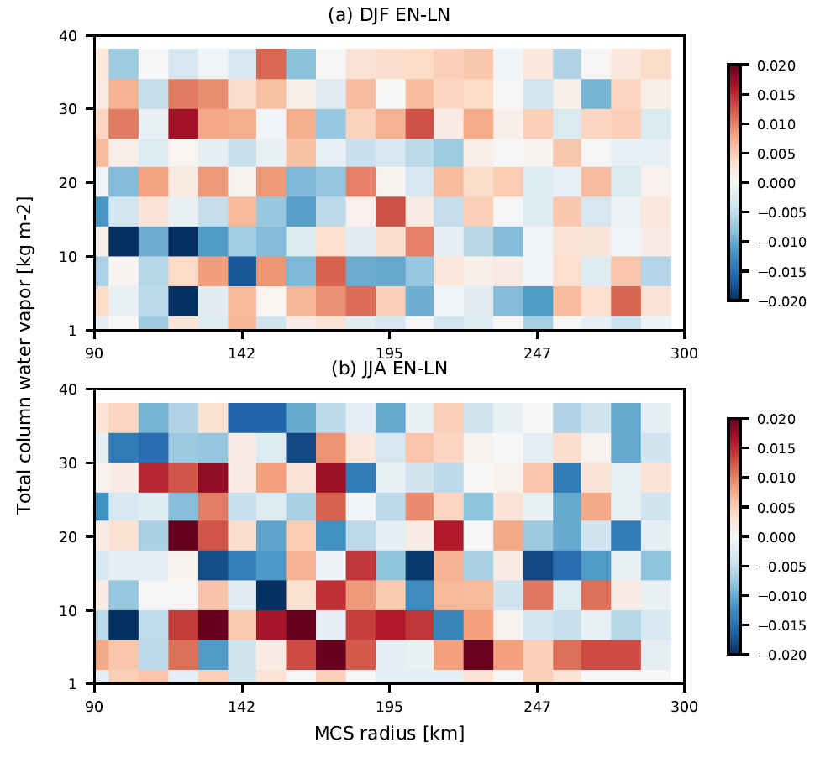
Slight shifts in density toward larger systems with low column moisture during the cold phase…
…but not an especially resilient signal.

Slide 21
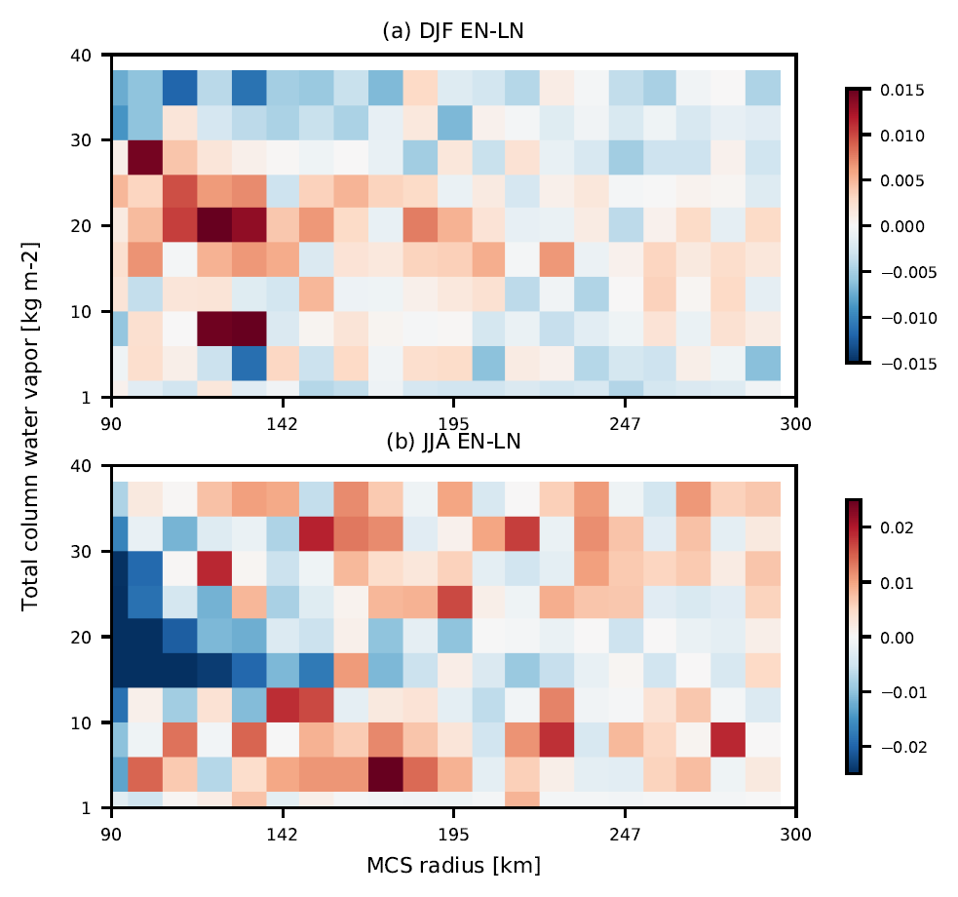
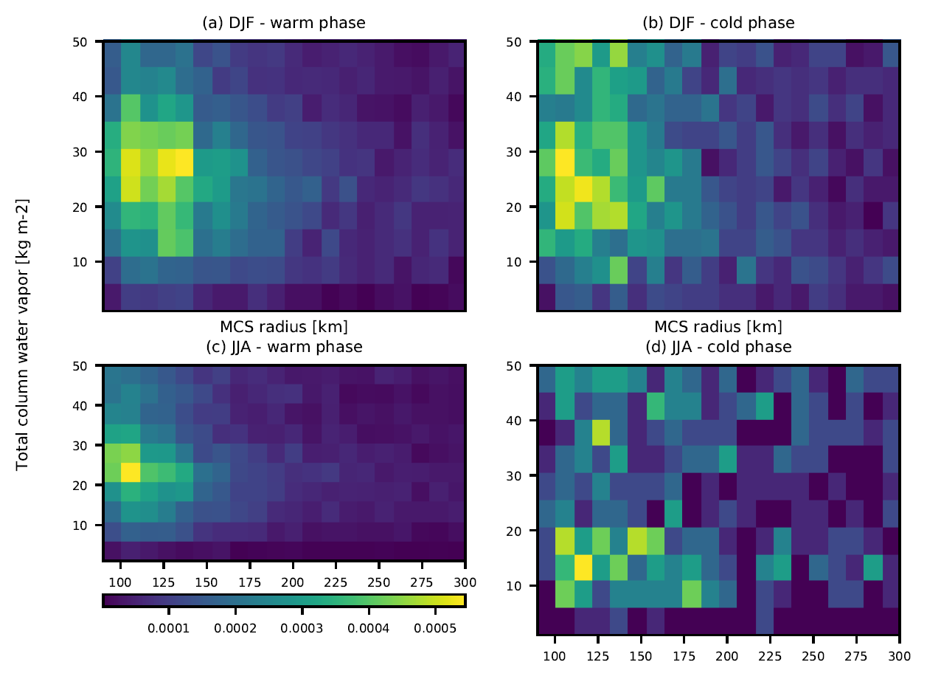
Again, slight shifts toward larger systems with low moisture during the cold phase …
…but the coherence of the warm phase distribution is more impressive.

Slide 22
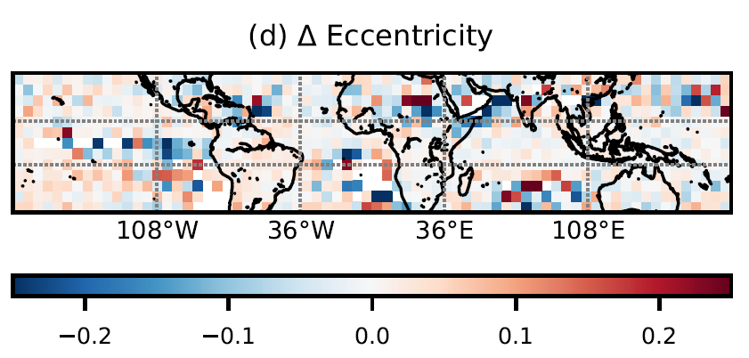
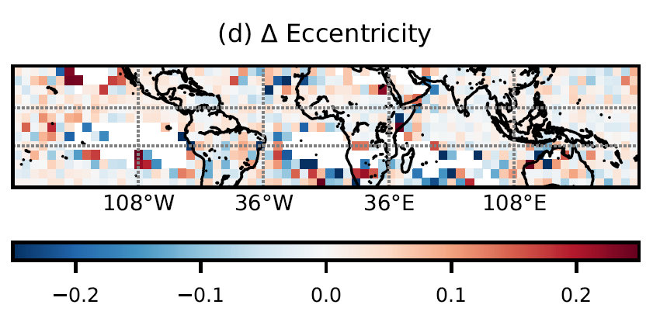
DJF climatology
A slight, large-scale increase in MCS eccentricity occurs with warming.
JJA climatology
Notes:
Blue means the value is larger in a La Nina year; red in an El Nino year.
FREQUENCY:
Very expected Pacific “dipole” behavior:
Increase in the MCS frequency over the central Pacific where the SST increase is greatest.
But the region of increased frequency also extends all the way eastward to the South American coast.
(2) Decrease in the MCS frequency over the west Pacific (Maritime Continent) where the SST has dropped.
But there are also decreases in frequency of passage over the Amazon, Sahel, and Indian Ocean during the warm phase.

Slide 23
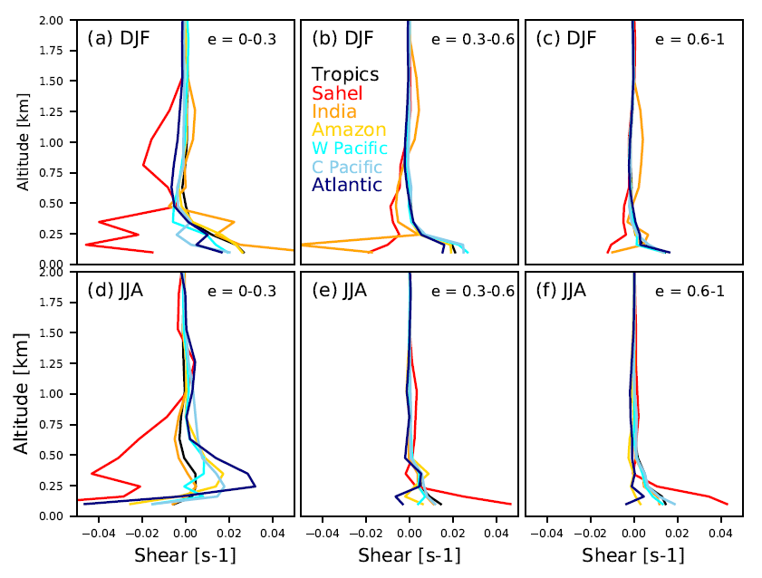
How do changes in the dynamical environment affect structure?
Notes:
If there is strong, low-level shear, vertical motions within the storm will be slant-wise down this gradient, a kind of layer ascent.
Can we explain this with a trade wind weakening that adjusts the vertical shear profile?
Shear profiles over the Sahel are anomalous.
Largest warm-cold phase differences for the most elongated systems.

